Slide 1
Precise Text Alignment
a story about Fonts Metrics and CSS

Slide 2
Precise Text Alignment
by Elika J. Etemad (W3C CSSWG) & Ethan Wang (Microsoft)

Slide 3
In the beginning…

Slide 4
Pre-CSS Model of Text on the Web
Notes:
There were only two vertical metrics used in CSS: ascent and descent.

Slide 5
Pre-CSS Model of Text on the Web

Slide 6
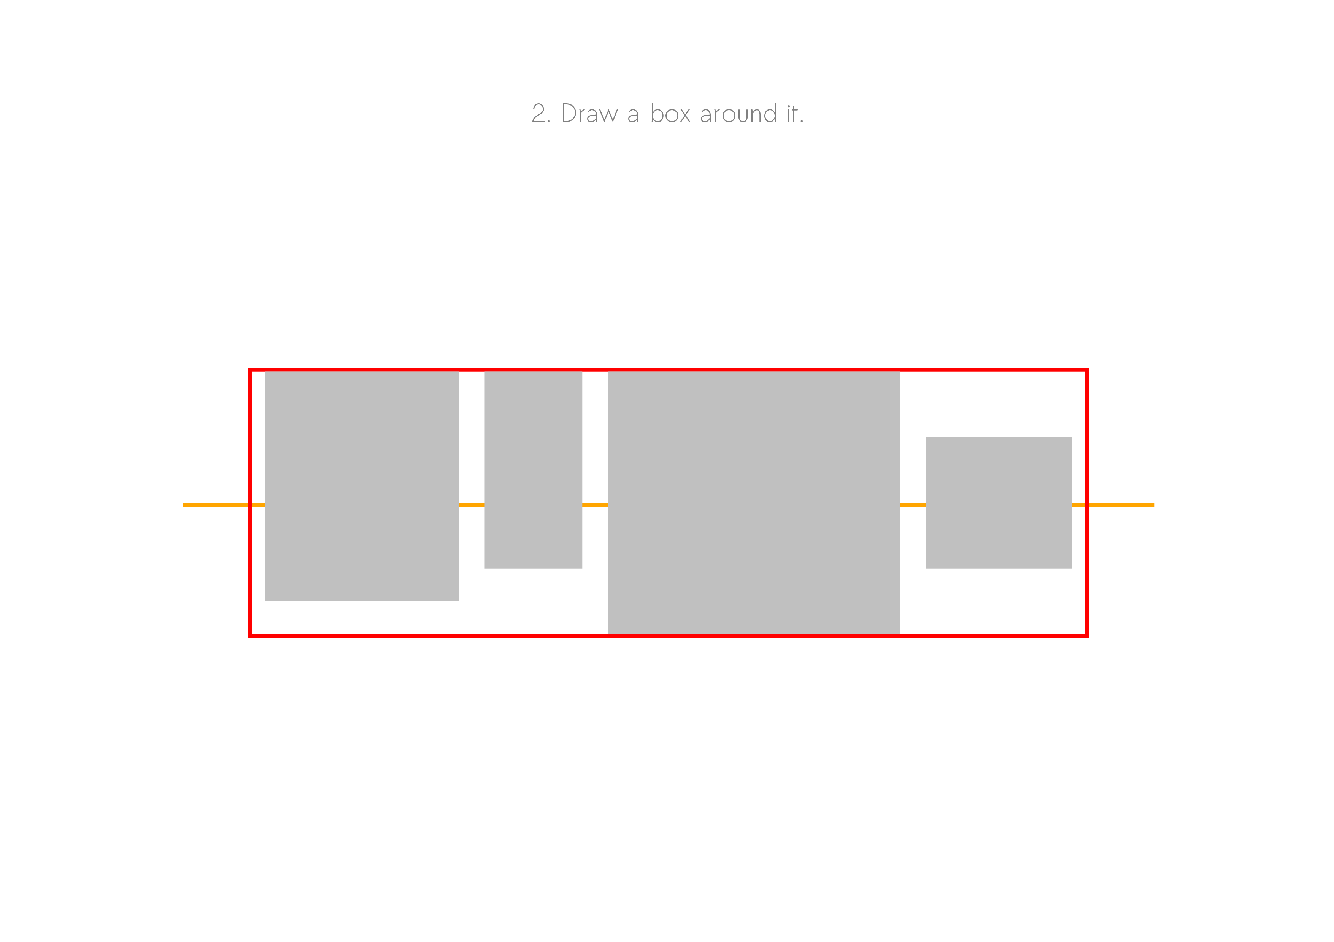
Pre-CSS Model of Text on the Web

Slide 7
Pre-CSS Model of Text on the Web

Slide 8
Pre-CSS Model of Text on the Web

Slide 9
Pre-CSS Model of Text on the Web
Notes:
There was no way to add spacing. If you wanted a gap, you could insert a blank line or an invisible image.

Slide 10
CSS introduces leading…
line-height: <length> | <number> | <percentage>;
Notes:
CSS1 introduced margins, padding… and control over line spacing!

Slide 11
CSS introduces leading…
Notes:
Adding space after each line would give inconsistent spacing at the start vs. the end of a paragraph. Only adding leading between lines of text would create uneven spacing within vs. between paragraphs. So CSS added leading symmetrically to each line: half on either side.

Slide 12
CSS introduces leading…
line-height: 1.5;
/* 1.5 x font-size */

Slide 13
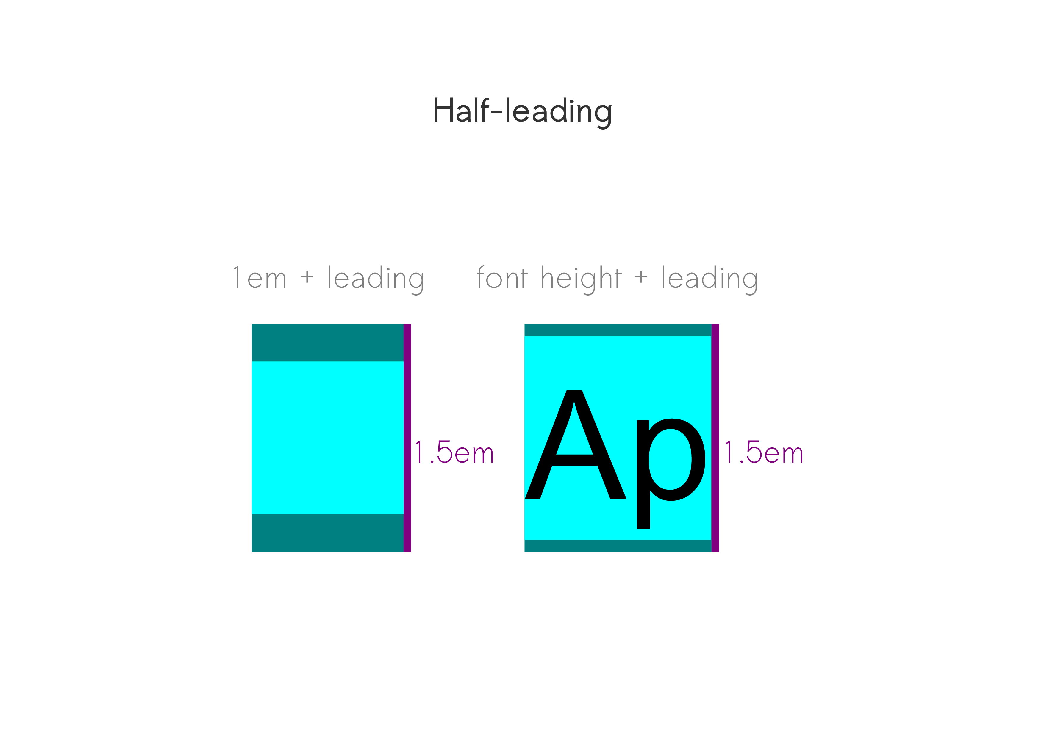
Notes:
Height of line is calculated wrt font-size, but half-leading is calculated wrt ascent/descent metrics, because those are the bounds of the text.

Slide 14
Problem 1: Inconsistent Line Spacing

Slide 15
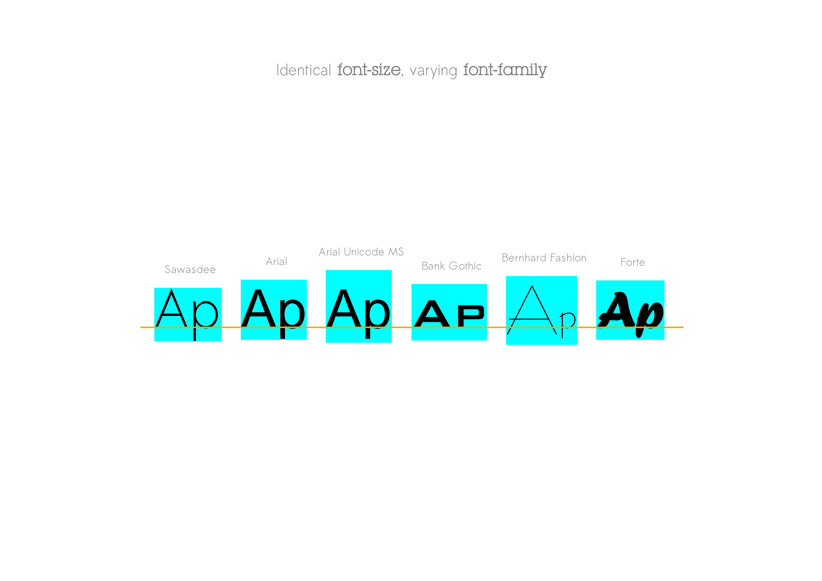

Slide 16
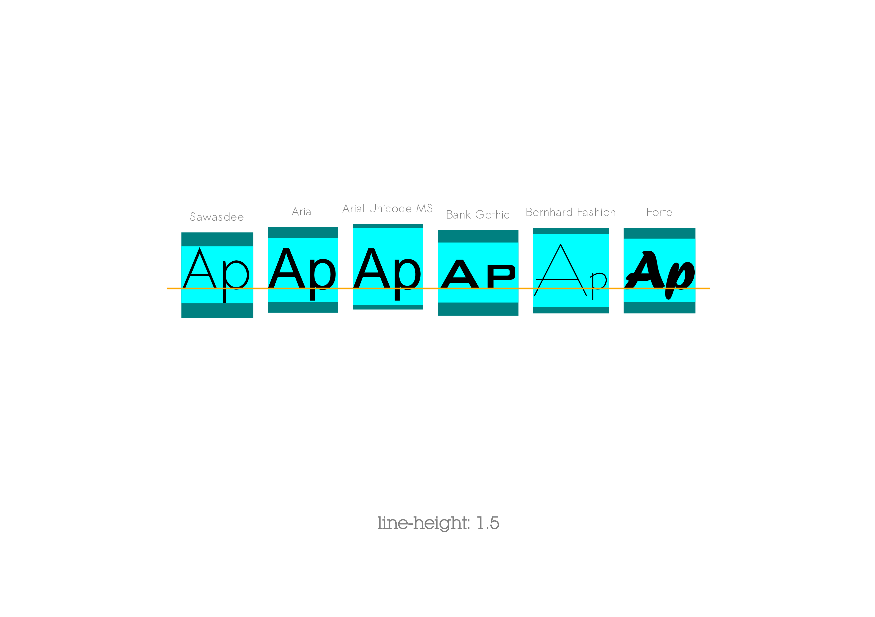
Notes:
Multiple fonts on one line…

Slide 17
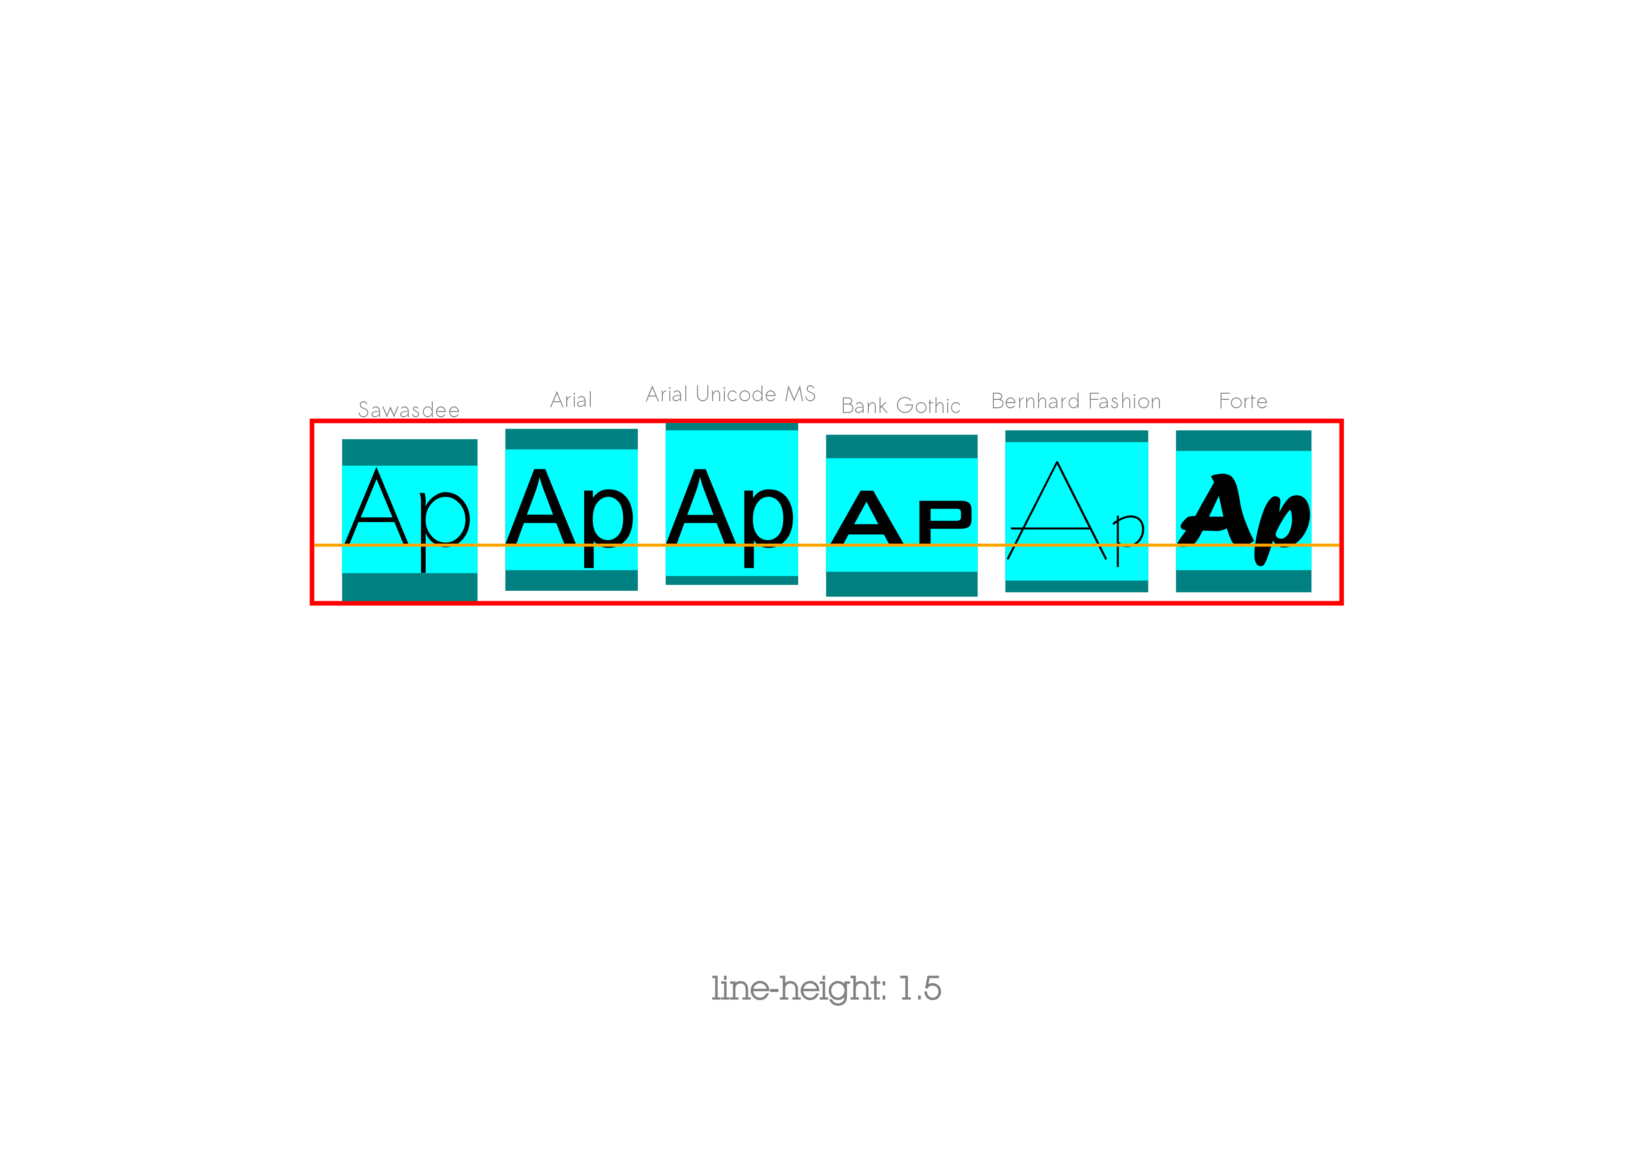
Notes:
… means height of line ≠ line-height!

Slide 18
Problem 2: Imperfect Alignment

Slide 19
CSS Text Model

Slide 20
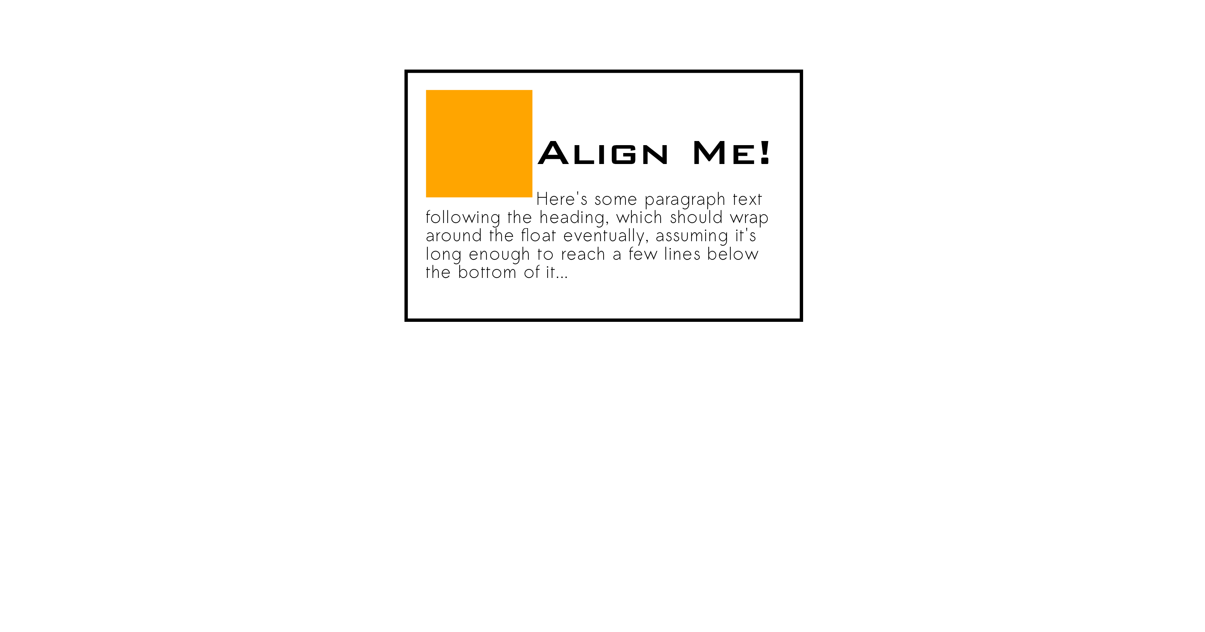
Visual Misaligment: Top Edge
Notes:
Top-aligned content includes half-leading, doesn’t align well with adjacent content. REDO DIAGRAM to make the top edge more accurate to half-leading…

Slide 21
Visual Misalignment: Top Edge
Notes:
But even if we trim the half-leading, there’s the extra space within the ascent metric.

Slide 22
Vertical Misalignment: Top Edge
Notes:
Negative margins… visual hacking.

Slide 23
Vertical Misalignment: Top Edge
Notes:
Fails whenever font is changed—whether because you’re tweaking your design, or because the font didn’t load and you got a different font instead.

Slide 24
Vertical Misalignment: Centering

Slide 25
Vertical Misalignment: Centering

Slide 26
Vertical Misalignment: Centering

Slide 27
Vertical Misalignment: Centering

Slide 28
Vertical Misalignment: Centering

Slide 29
Problem 3: Uncontrolled Spacing

Slide 30
Computer’s Spacing Numbers

Slide 31
Resulting Visual Spacing

Slide 32
Resulting Visual Spacing

Slide 33
Desired Visual Spacing

Slide 34
Desired Spacing

Slide 35
Print Workflow…

Slide 36
CSS Design Constraints
Unknown screen size/orientation/resolution
Unknown font availability
Often also unknown content!
➔ Automatic Layout (no post-render visual fiddling!)

Slide 37
This is bad.

Slide 38
CSS Design Principles
Flexible: Handle each font/content/screen-size change as if it was always intended to be that way.
Robust: Handle the unexpected font/content/screen-size changes, too.
#1 Goal: Don’t overlap or clip content by “accident”!!

Slide 39
CSS + Font Metrics
An Expanded Partnership

Slide 40
OpenType Font Metrics

Slide 41
New CSS Feature: leading-trim

Slide 42
leading-trim

Slide 43
leading-trim

Slide 44
leading-trim

Slide 45
leading-trim

Slide 46
Visual Spacing

Slide 47
Visual Spacing

Slide 48
Accurate, Automatic Alignment

Slide 49
Accurate, Automatic Alignment

Slide 50
Better Centering

Slide 51
Better Centering

Slide 52
Better Centering

Slide 53
Better Centering

Slide 54
Better Centering

Slide 55
Better Centering

Slide 56
New CSS Feature: Alternate Line Box Model

Slide 57
Alternate definition of “fit” for a line

Slide 58
Alternate definition of “fit” for a line

Slide 59
New CSS Feature: Additional Baseline Options

Slide 60
INSERT BASELINE SLIDES

Slide 61
New CSS Feature: Automatic Initial Letters

Slide 62
Proper Drop-caps

Slide 63
Proper Drop-caps
Notes:
Given accurate metrics, the browser can automatically calculate the correct drop-cap size and position.

Slide 64
Problems with Font Metrics

Slide 65
Different Platforms use Different Ascent/Descent Metrics
Notes:
There are multiple ascent/descent metrics tables in OpenType…

Slide 66
Some Fonts Have Bad Metrics

Slide 67
OpenType lacks metrics for non-Western/CJK writing systems ☹

Slide 68
What CSSWG is doing to compensate
We’re adding font metric overrides in CSS, so authors can override bad or missing metrics:
@font-face {
…
advance-override: …;
descent-override: …;
superscript-size-override: …;
superscript-shift-override: …;
etc.
}

Slide 69
How You Can Help
Font designer? → Ensure accurate metrics in your fonts!
Font tool vendor? → Facilitate accurate metrics in your output!
Font technologist? → Expand OpenType metrics to the rest of the world!

